Slide 1
2 Darstellungs-Varianten zur Auswahl à 3 Folien

Slide 2
Max Mustermann
Future Goals and Aspirations:
Bulletpoints
Picture
Variante A
YY - YY Position, Institution/Location
YY - YY Position, Institution/Location
YY - YY Position, Institution/Location
YY - YY Education, Location
Need for Network and Support:
Bulletpoints
Memberships or Functions in scientific committees, editorial & expert activities:
Bulletpoints
Hobbies:
Bulletpoints

Slide 3
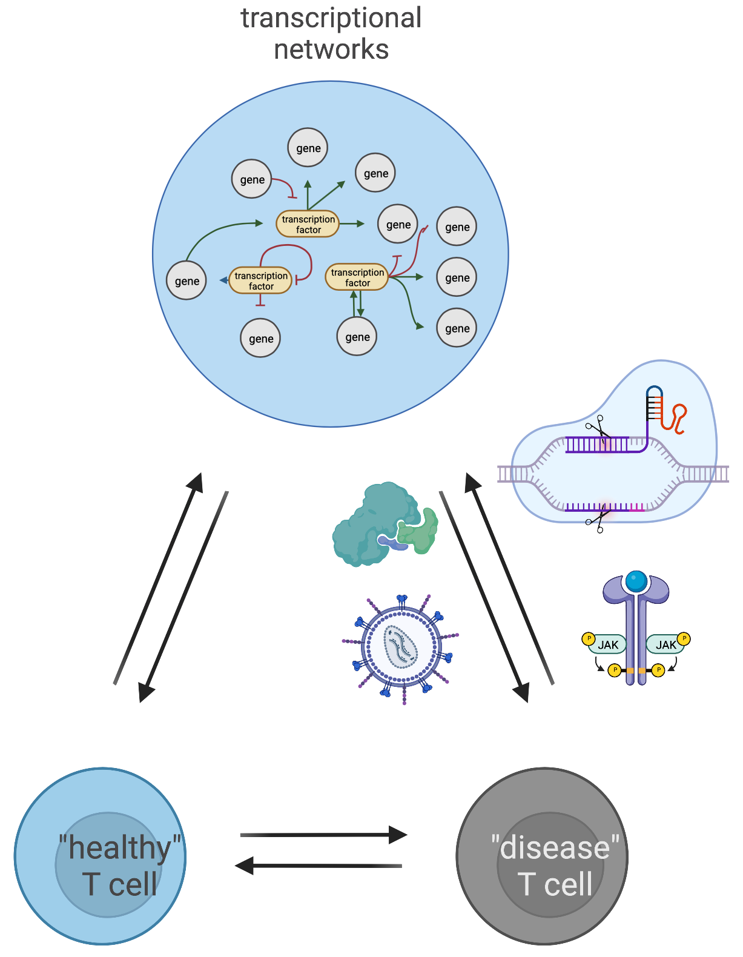
Max Mustermann … Research at a Glance
Research Interests:
Immunology/Genetics/Cell Biology
CRISPR engineering of human T cells
Transcription factors/epigenetic factors in T cell function and stability
Regulatory T cells
Exhausted T cells
TCR/CAR-T cells with improved effector functions
Technologies:
CRISPR
Gene knockouts
Gene knockins
CRISPR screens
Flow cytometry
Genetics
Molecular Biology
PCR
Amplicon PCR/NGS
ATAC-seq
RNA-seq
cloning

Slide 4
Max Mustermann …
Optional: 1x frei verfügbare Folie z.B. zur Vertiefung eines Aspektes, Vorstellung des MCSP-Projektes, …

Slide 5
Max Mustermann
Research Interests:
Immunology/Genetics/Cell Biology
CRISPR engineering of human T cells
Transcription factors/epigenetic factors in T cell function and stability
Regulatory T cells
Exhausted T cells
TCR/CAR-T cells with improved effector functions
Future Goals and Aspirations:
Bulletpoints
Picture
Variante B
YY - YY Position, Institution/Location
YY - YY Position, Institution/Location
YY - YY Position, Institution/Location
YY - YY Education, Location
Need for Network and Support:
Bulletpoints
Technologies:
CRISPR
Gene knockouts
Gene knockins
CRISPR screens
Flow cytometry
Genetics
Molecular Biology
PCR
Amplicon PCR/NGS
ATAC-seq
RNA-seq
cloning
Memberships or Functions in scientific committees, editorial & expert activities:
Bulletpoints
Hobbies:
Bulletpoints

Slide 6
Max Mustermann … Research at a Glance

Slide 7
Max Mustermann …
Optional: 1x frei verfügbare Folie z.B. zur Vertiefung eines Aspektes, Vorstellung des MCSP-Projektes, …

