Slide 1

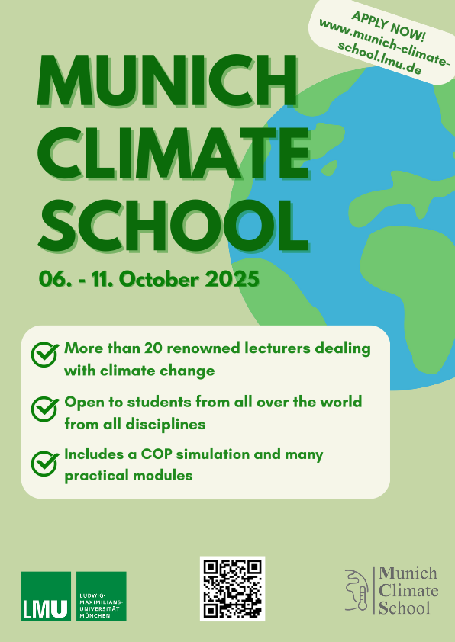
www.munich-climate-school.lmu.de
Apply now until 15 June!
Munich Climate school 2025
Munich Climate School 2025

